Slide 1
Monolithic, Biocompatible, Feedthrough for Hermetically Sealed Electronics and Methods of Manufacture
Neuralink, US 2021/0013051, 1/14/2021
3/25/2024

Slide 2
Outline
Goal: Describe methods to manufacture a biocompatible, hermetic feedthrough monolithically integrated with a biocompatible ribbon cable + resulting devices
Embodiments:
Human Head with BMI Implants
Implants with & without cover
Exploded view of implant
Perspective bottom view of the ribbon cable
Elevation cross-section view schematic
Manufacturing process of glass hermetic feedthrough and integrated flex/ribbon cable

Slide 3
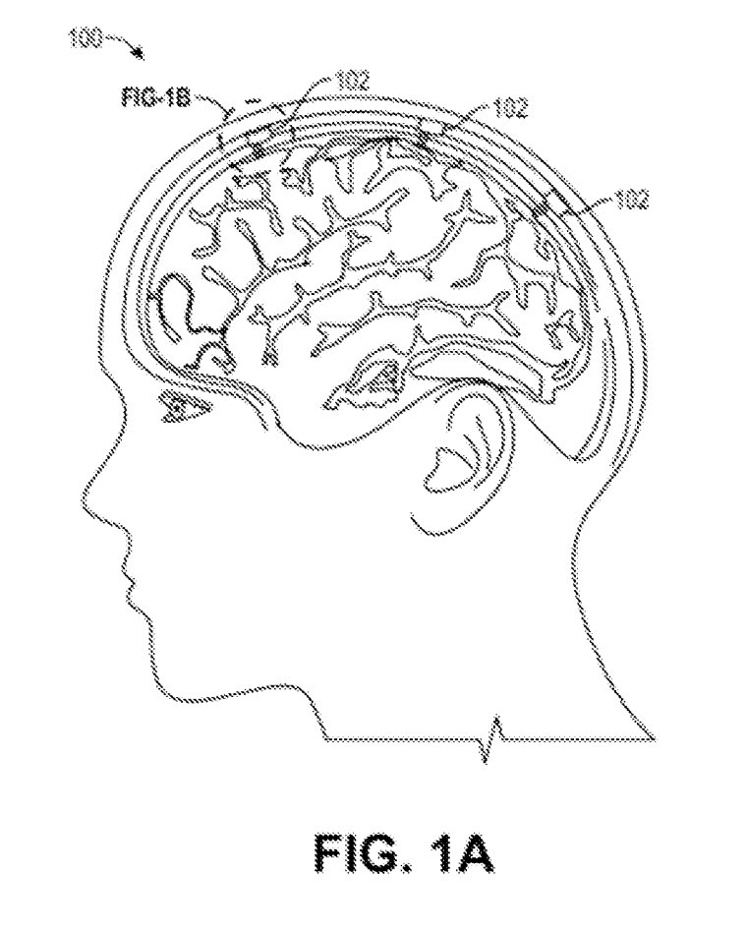
Human head with BMI implants

Slide 4
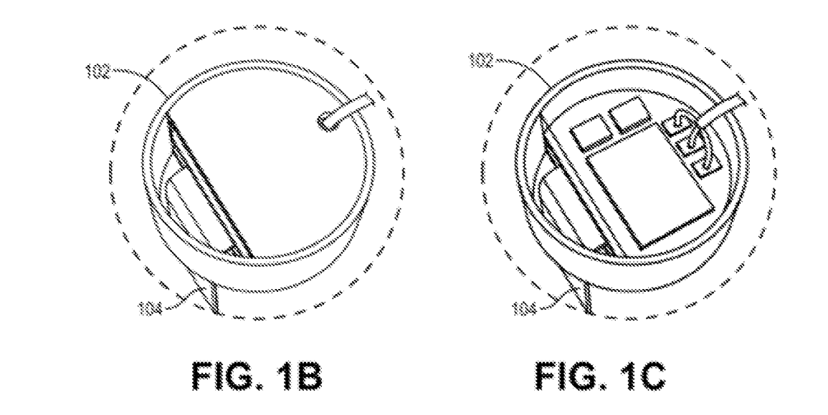
Implants with & without cover

Slide 5
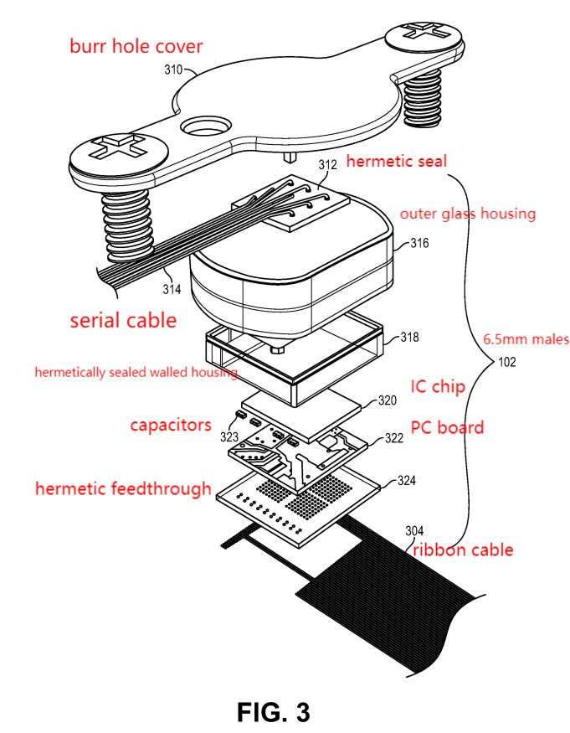
Exploded View of Implant

Slide 6
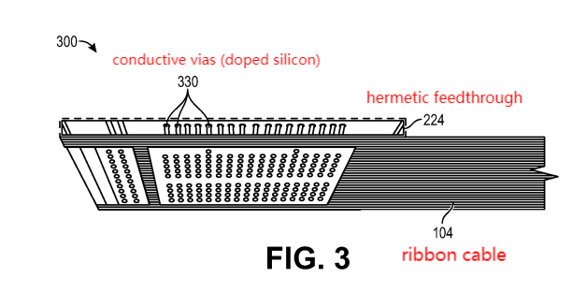
Perspective bottom view of ribbon cable

Slide 7
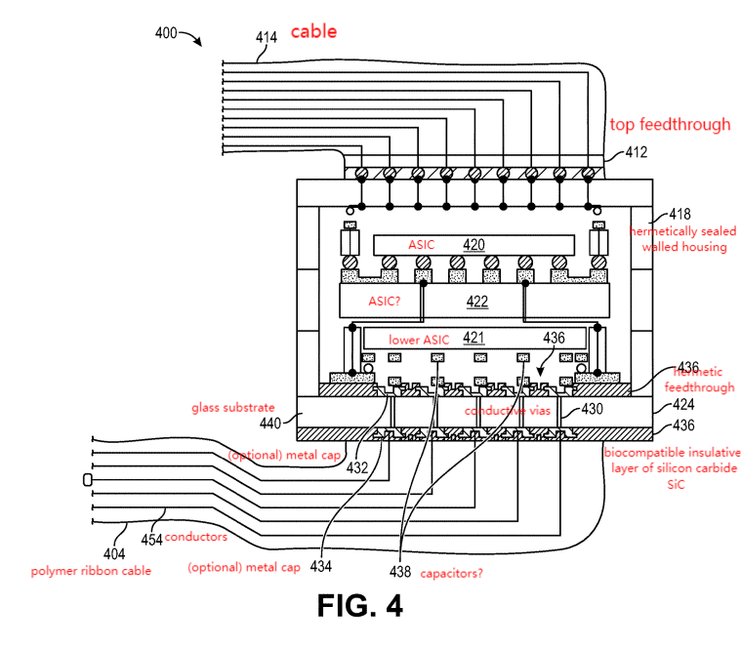
Elevation cross-section view schematic

Slide 8
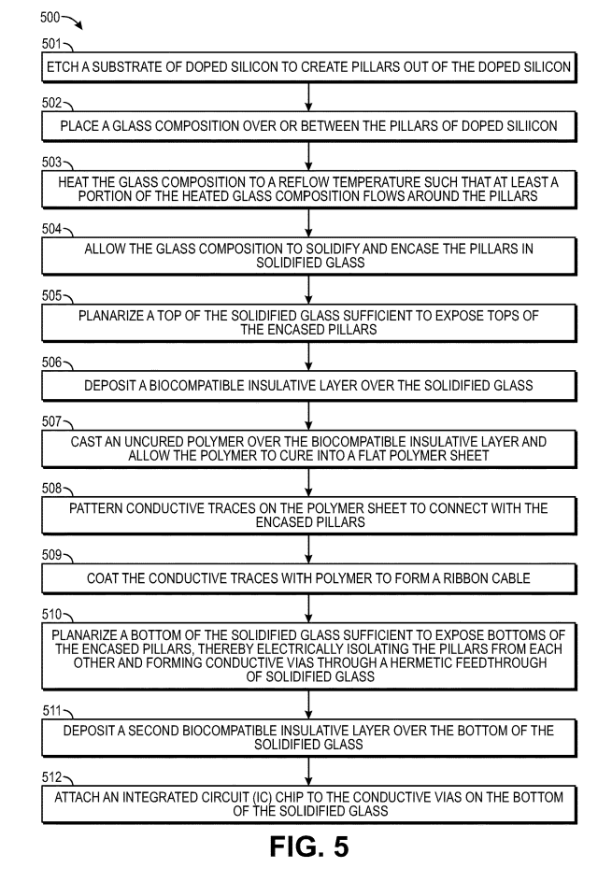
Procedure in flowchart

Slide 9
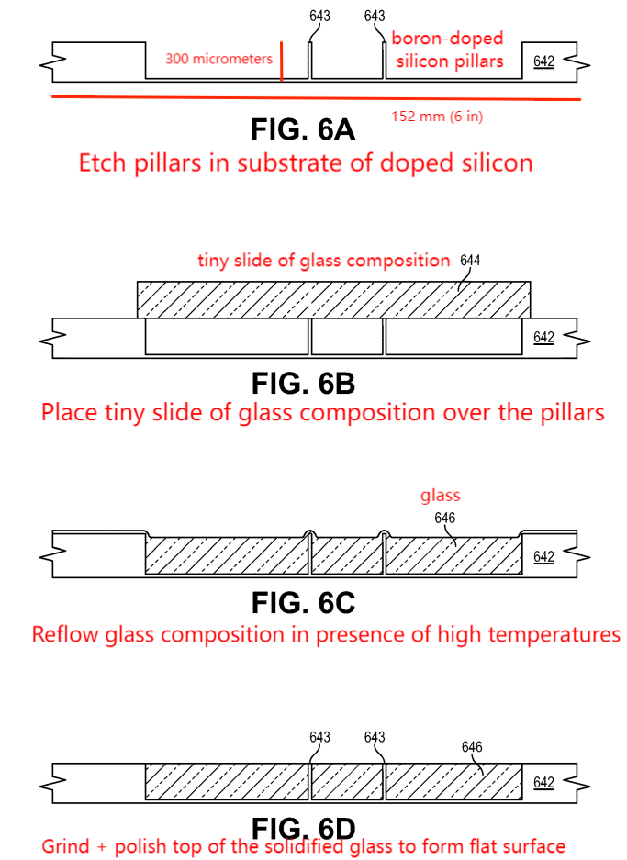
Step 1

Slide 10
Step 2

Slide 11
Step 3 + 4

Slide 12
Step 5

Slide 13
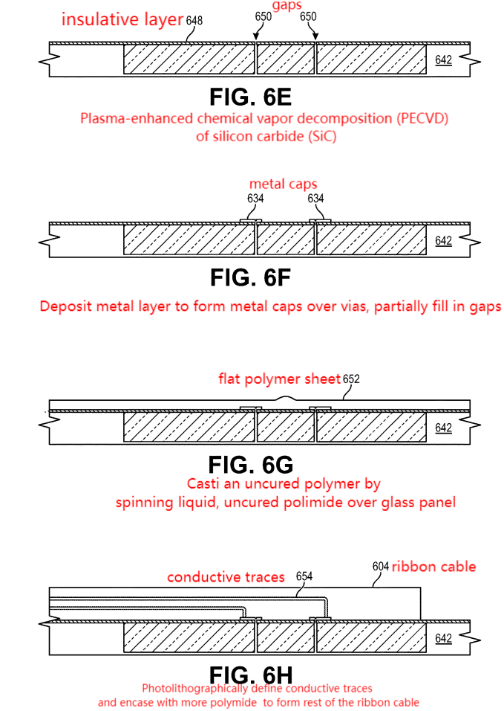
Step 6

Slide 14
Step 7

Slide 15
Step 8 + 9

Slide 16
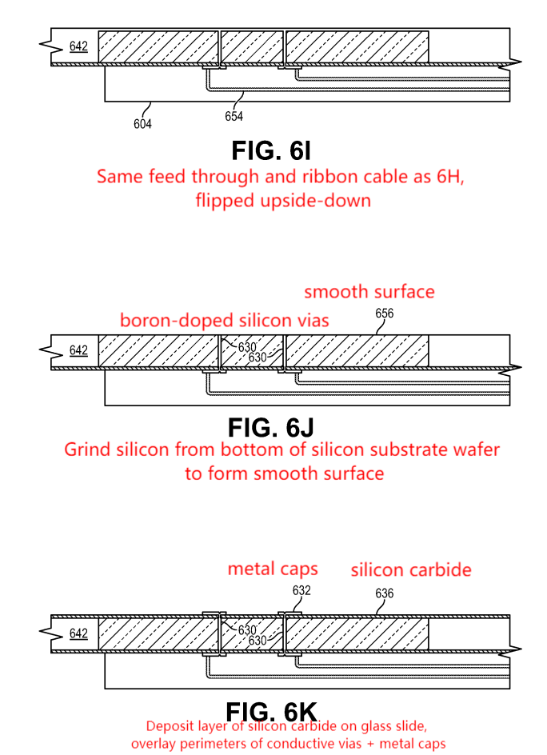
Step 10

Slide 17
Step 11

Slide 18
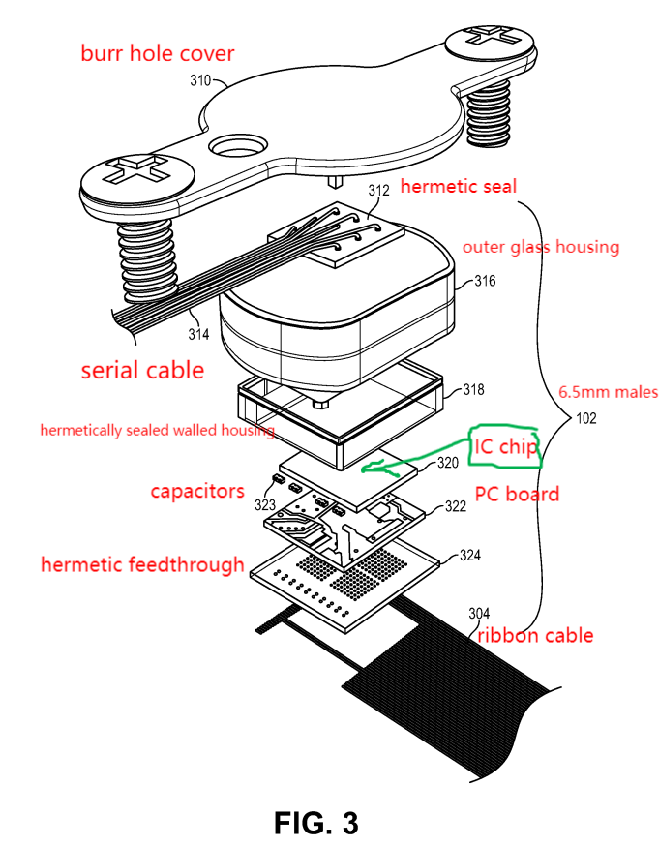
Step 12

